Slide 1
MSCF Programming Prep
46-900
MSCF, Carnegie Mellon University
Day 7, Part 1:
Balanced Binary Trees,
Red-Black Trees

Slide 2
Linked List Search Time
To search an N-node (unsorted) linked list for a value, how many nodes must we look at?
  Very rarely, just one
  Much more often, all N
    The value might not be in the list at all!
A linked list has O(N) search time
  If N doubles, search time doubles
Notes:
So we might say
Complex a, b, c;
a.real = 1.0; a.imag = 2.0;
b.real = 3.0; b.imag = 4.0;
c = mult(a, b);
The big problem here is that the function name mult() can’t be used for any other purpose in the same program. It’s global function, tied to the Complex struct. We can do better.

Slide 3
Unbalanced BST
To search an N-node (unbalanced) binary search tree for a value (no duplicates), how many nodes must we look at?
  Very rarely, just one 0
  In the worst cases, all N 1
    If values were inserted in order! 2
3
4
Notes:
So we might say
Complex a, b, c;
a.real = 1.0; a.imag = 2.0;
b.real = 3.0; b.imag = 4.0;
c = mult(a, b);
The big problem here is that the function name mult() can’t be used for any other purpose in the same program. It’s global function, tied to the Complex struct. We can do better.

Slide 4
Unbalanced BST (cont.)
If values are inserted into an unbalanced BST in "random" order, the tree tends to be "better balanced"
  That is, branches from root to leaf are closer to the same length
    To search this tree of 10 nodes, we examine at most 4
    15
    10 22
    8 12 27
    5 9 24 33
Notes:
So we might say
Complex a, b, c;
a.real = 1.0; a.imag = 2.0;
b.real = 3.0; b.imag = 4.0;
c = mult(a, b);
The big problem here is that the function name mult() can’t be used for any other purpose in the same program. It’s global function, tied to the Complex struct. We can do better.

Slide 5
Balanced BST
In a balanced BST, the depths of the left and right subtrees are within 1 at every level in the tree
  The previous slide's tree was not balanced at 22
    This tree is balanced
    15
    10 22
    8 12 18 27
    5 9 13 24 33
Notes:
So we might say
Complex a, b, c;
a.real = 1.0; a.imag = 2.0;
b.real = 3.0; b.imag = 4.0;
c = mult(a, b);
The big problem here is that the function name mult() can’t be used for any other purpose in the same program. It’s global function, tied to the Complex struct. We can do better.

Slide 6
Complete BST
In a complete BST, the depths of the left and right subtrees are the same at every level in the tree
  Every node is "filled in" up to that depth
    This tree is complete
    15
    10 22
    8 12 18 27
    5 9 11 13 17 19 24 33
Notes:
So we might say
Complex a, b, c;
a.real = 1.0; a.imag = 2.0;
b.real = 3.0; b.imag = 4.0;
c = mult(a, b);
The big problem here is that the function name mult() can’t be used for any other purpose in the same program. It’s global function, tied to the Complex struct. We can do better.

Slide 7
Search Time: Complete BST
Notice that a complete BST has 2^{D} - 1 nodes, where D is the depth
  D is also the maximum number of nodes we need to examine when searching for a value
    That is, about 2^{D} nodes implies a search time of
    D == log₂(2^{D})
Or, given N nodes, search time is O(log N)
  If N doubles, search time increases by 1, no matter the size of N!
Notes:
So we might say
Complex a, b, c;
a.real = 1.0; a.imag = 2.0;
b.real = 3.0; b.imag = 4.0;
c = mult(a, b);
The big problem here is that the function name mult() can’t be used for any other purpose in the same program. It’s global function, tied to the Complex struct. We can do better.

Slide 8
Search Time: Balanced BST
A balanced BST is "close enough" to complete, so search time is O(log N)
  If N doubles, search time increases by 1, no matter the size of N!
To give some idea:
  2⁵⁰ is about 1,126,000,000,000,000
    1.126 quadrillion
    For any data problem you are likely to face, it's safe to assume that log N is less than 100
Notes:
So we might say
Complex a, b, c;
a.real = 1.0; a.imag = 2.0;
b.real = 3.0; b.imag = 4.0;
c = mult(a, b);
The big problem here is that the function name mult() can’t be used for any other purpose in the same program. It’s global function, tied to the Complex struct. We can do better.

Slide 9
Problem: How To Maintain A Balanced BST
Maintaining a balanced BST is expensive
  Inserting/deleting a node may require lots of node shuffling
Can we maintain a "nearly balanced" BST?
  Still guaranteed O(log N) search
  Not too much node shuffling
Self-balancing trees include: 2-3 tree, AA tree, AVL tree, splay tree, red-black tree
Notes:
So we might say
Complex a, b, c;
a.real = 1.0; a.imag = 2.0;
b.real = 3.0; b.imag = 4.0;
c = mult(a, b);
The big problem here is that the function name mult() can’t be used for any other purpose in the same program. It’s global function, tied to the Complex struct. We can do better.

Slide 10
Red-Black Tree Properties
A red-black tree is defined by its properties:
1) Each node is red or black
(arbitrary labels: colors have no actual significance)
2) Root node is black; each leaf (a dataless "node")
is black
3) Each red node's parent is black
4) Given a node, each (direct) path to a lower leaf
has the same number of black nodes
*) Called the black height of the node
Claim: a red-black tree with no red nodes is complete
Notes:
So we might say
Complex a, b, c;
a.real = 1.0; a.imag = 2.0;
b.real = 3.0; b.imag = 4.0;
c = mult(a, b);
The big problem here is that the function name mult() can’t be used for any other purpose in the same program. It’s global function, tied to the Complex struct. We can do better.

Slide 11
Red-Black Tree Examples
black height: 3 black height: 2
9 12
6 15 8 20
3 8 10 17 17 27
13 24
Notes:
So we might say
Complex a, b, c;
a.real = 1.0; a.imag = 2.0;
b.real = 3.0; b.imag = 4.0;
c = mult(a, b);
The big problem here is that the function name mult() can’t be used for any other purpose in the same program. It’s global function, tied to the Complex struct. We can do better.

Slide 12
Search Time: Red-Black Tree
A red-black tree has O(log N) search time
  Any path from root to leaf has a black height ~log N
    The black height of each such path must be the same
  The depth of a branch can have at most as many red nodes as black
    Each red node has a black parent
  2 log N is still O(log N)
    Doubling N increases search time by just 2
Notes:
So we might say
Complex a, b, c;
a.real = 1.0; a.imag = 2.0;
b.real = 3.0; b.imag = 4.0;
c = mult(a, b);
The big problem here is that the function name mult() can’t be used for any other purpose in the same program. It’s global function, tied to the Complex struct. We can do better.

Slide 13
Red-Black Tree Insert
As with any BST, a new node goes at a leaf
Color the new node red
1) If new node is the root, repaint it black -- DONE!
2) If new node's parent is black -- DONE!
3) If new node's parent and uncle are both red, repaint parent
and uncle black and grandparent red
*) Recurse on the red grandparent
Notes:
So we might say
Complex a, b, c;
a.real = 1.0; a.imag = 2.0;
b.real = 3.0; b.imag = 4.0;
c = mult(a, b);
The big problem here is that the function name mult() can’t be used for any other purpose in the same program. It’s global function, tied to the Complex struct. We can do better.

Slide 14
Red-Black Tree Insert (cont.)
Notes:
So we might say
Complex a, b, c;
a.real = 1.0; a.imag = 2.0;
b.real = 3.0; b.imag = 4.0;
c = mult(a, b);
The big problem here is that the function name mult() can’t be used for any other purpose in the same program. It’s global function, tied to the Complex struct. We can do better.

Slide 15
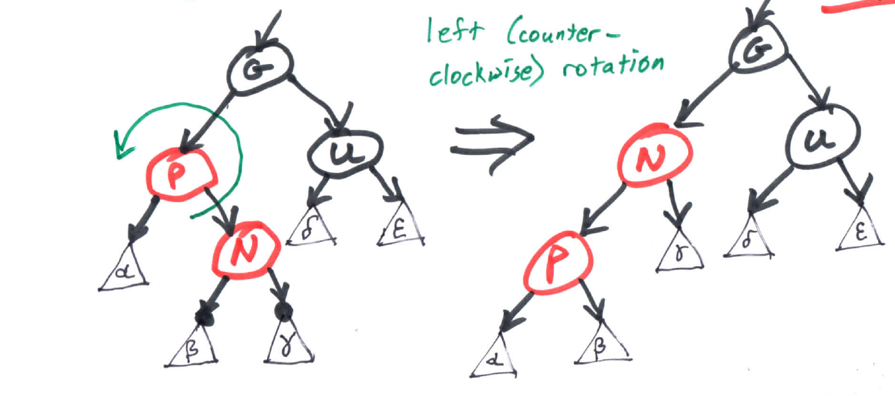
Red-Black Tree Insert (cont.)
4) If new node's parent is red and uncle is black
A) If new node is right of parent, which is left of
grandparent, perform left rotation on parent
*) Recurse on parent (P)
Notes:
So we might say
Complex a, b, c;
a.real = 1.0; a.imag = 2.0;
b.real = 3.0; b.imag = 4.0;
c = mult(a, b);
The big problem here is that the function name mult() can’t be used for any other purpose in the same program. It’s global function, tied to the Complex struct. We can do better.

Slide 16
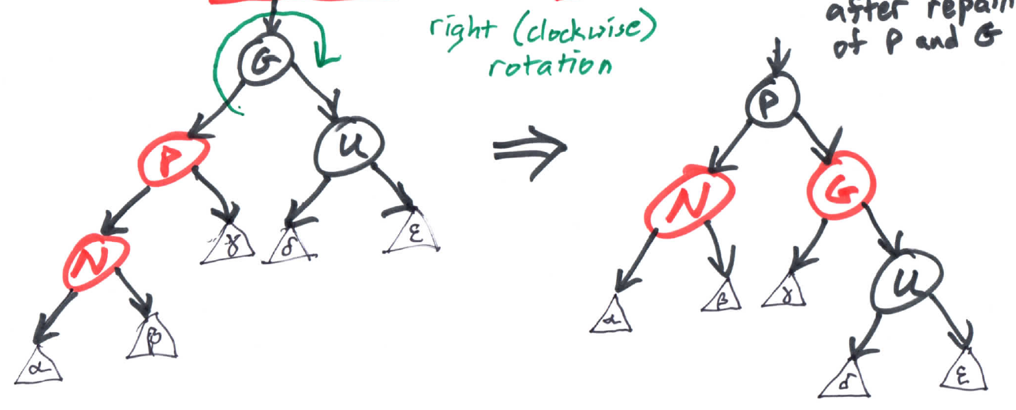
Red-Black Tree Insert (cont.)
4) If new node's parent is red and uncle is black
B) If new node is left of parent, which is left of
grandparent, perform right rotation on grandparent
-- DONE! after repaint of P and G
Notes:
So we might say
Complex a, b, c;
a.real = 1.0; a.imag = 2.0;
b.real = 3.0; b.imag = 4.0;
c = mult(a, b);
The big problem here is that the function name mult() can’t be used for any other purpose in the same program. It’s global function, tied to the Complex struct. We can do better.

Slide 17
Red-Black Tree Insert (cont.)
4) C, D) Mirror cases, when parent is right of grandparent
Notes:
So we might say
Complex a, b, c;
a.real = 1.0; a.imag = 2.0;
b.real = 3.0; b.imag = 4.0;
c = mult(a, b);
The big problem here is that the function name mult() can’t be used for any other purpose in the same program. It’s global function, tied to the Complex struct. We can do better.

